Slide 1
Hostel Management system
Cs258 group project -G3

Slide 2
About the Project
Overview
A web portal to manage Hostel
Project objective
Home Page, Registration, Login
Gallery
Complaints/Suggestions
Booking Rooms
Separate access for Warden, Staff and Students
Show profile and History of students
Manage Rooms and Complaints/Suggestions and pay bills

Slide 3
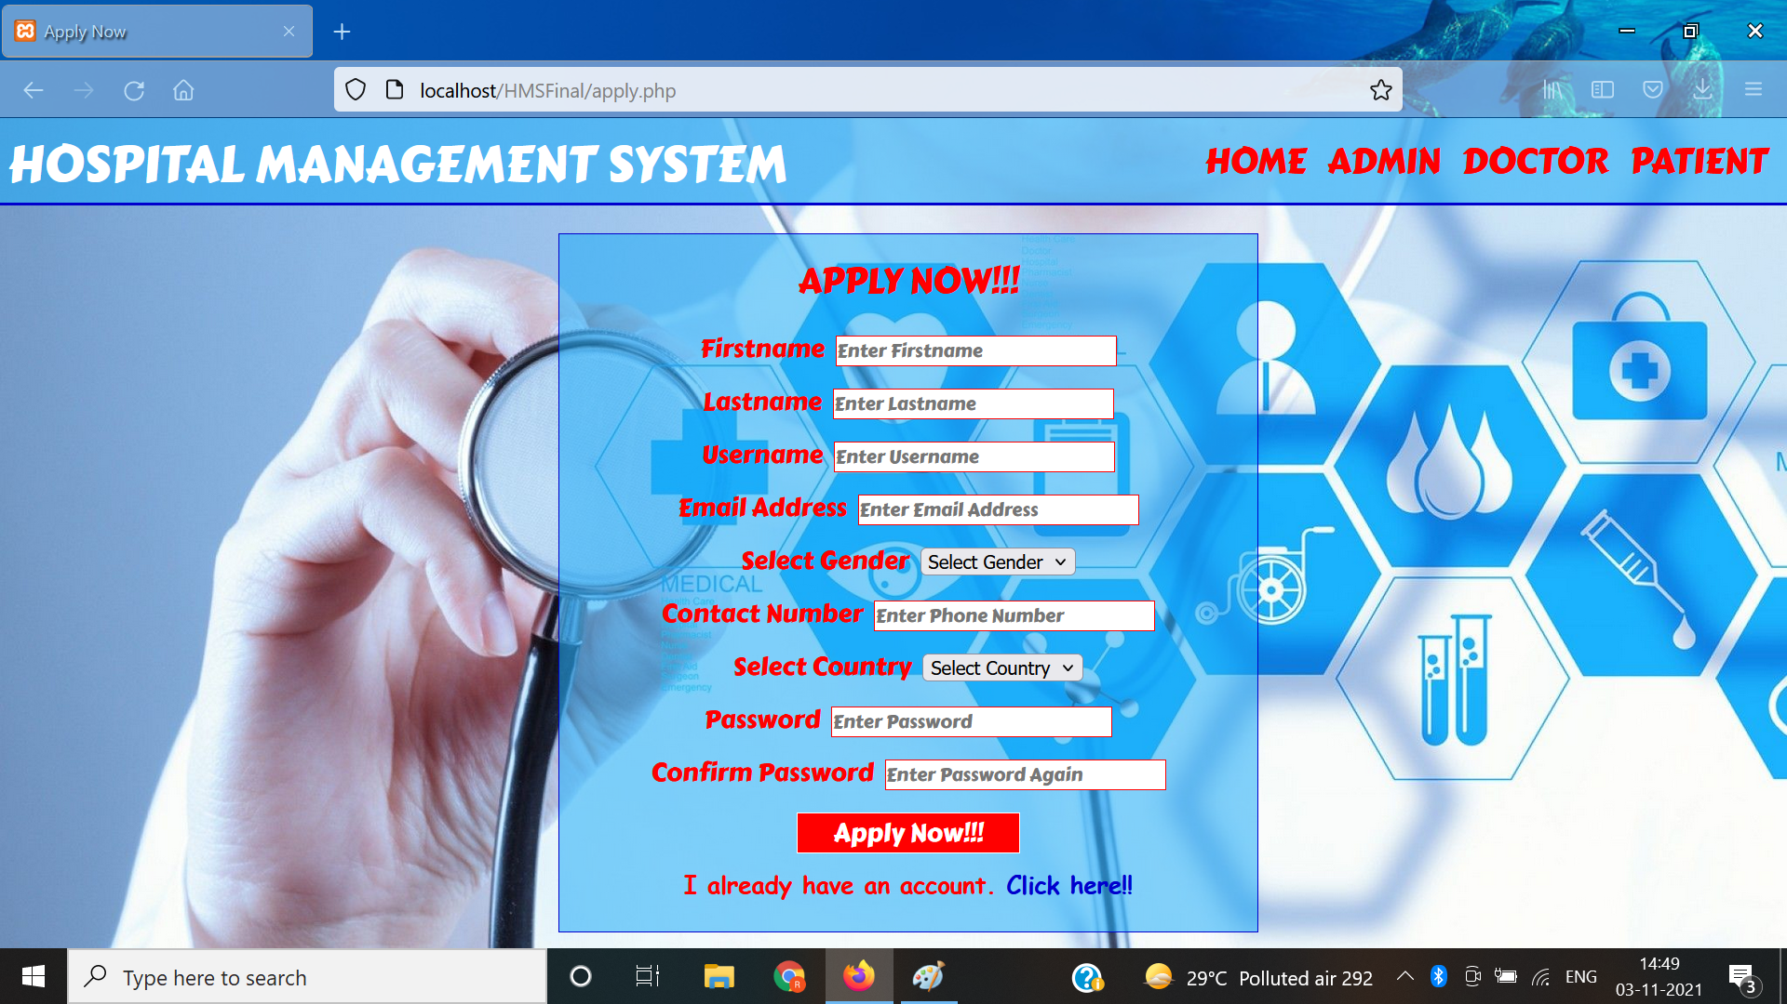
Application page

Slide 4
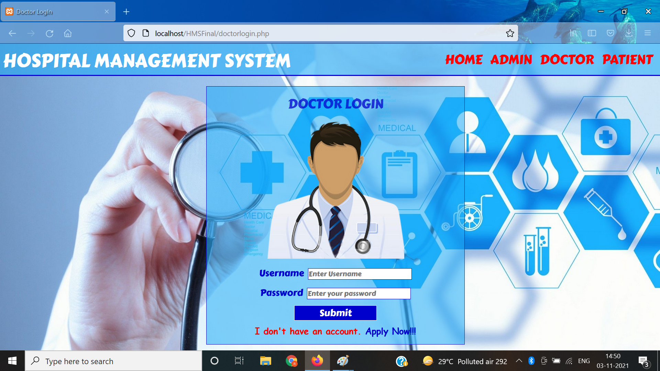
Doctor Login

Slide 5

Index Page

Slide 6

Admin Login Page

Slide 7
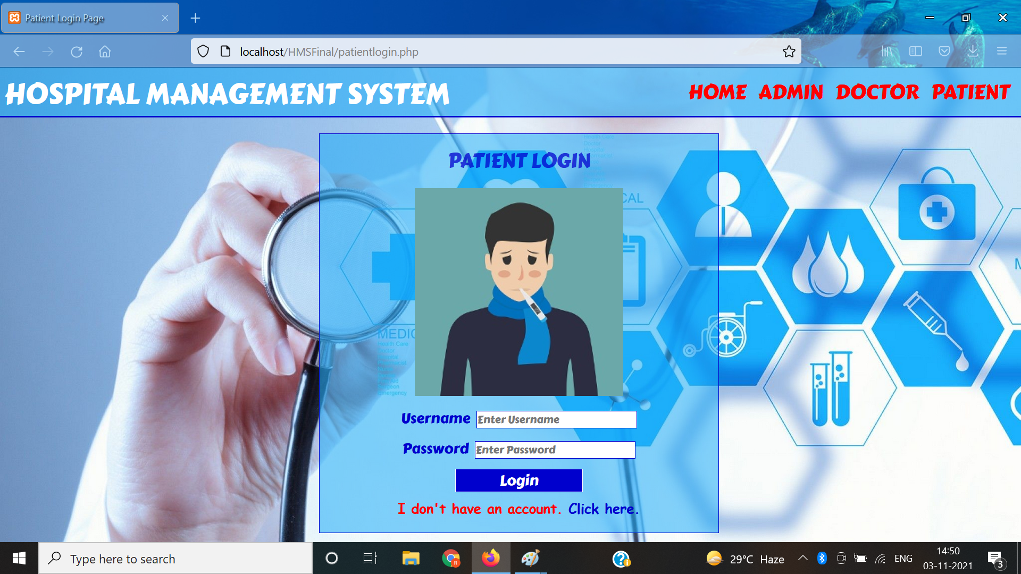
Patient Login

Slide 8
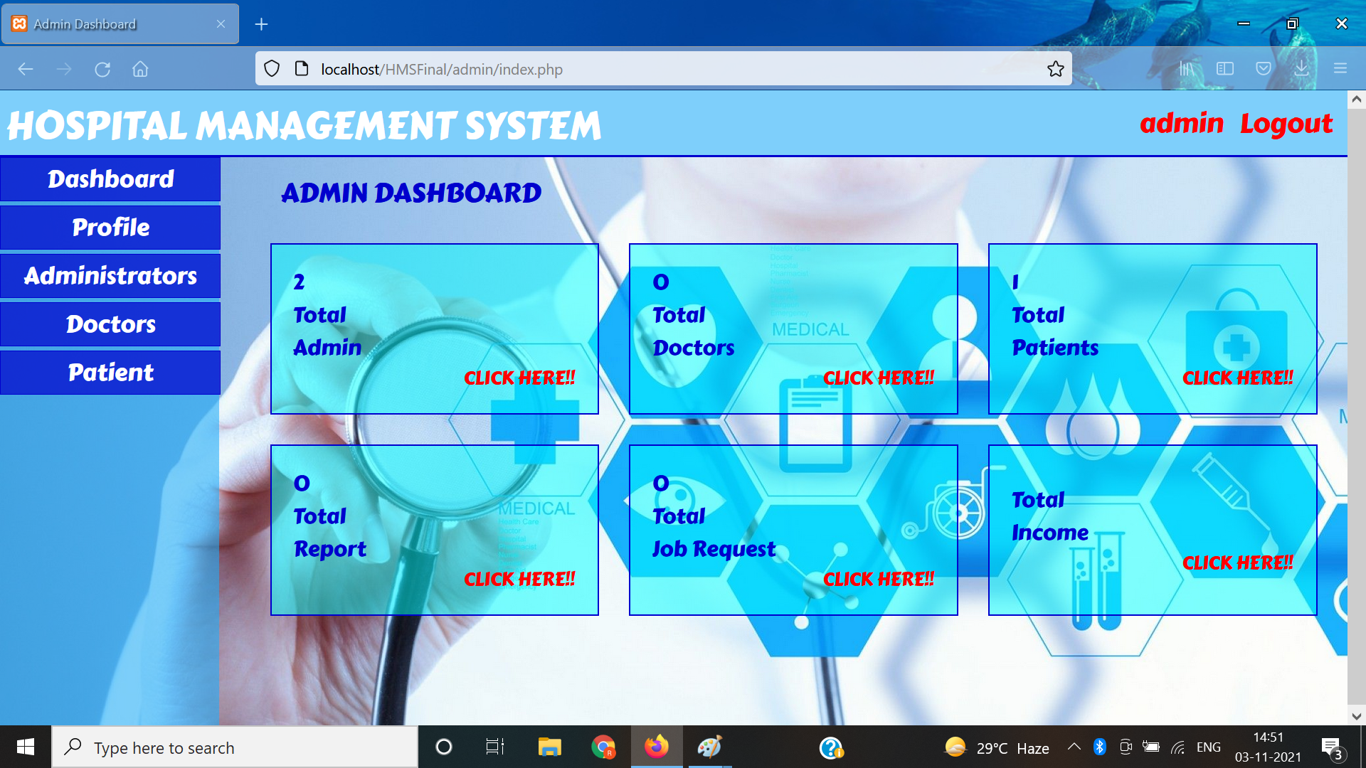
Admin Nav Preview

Slide 9
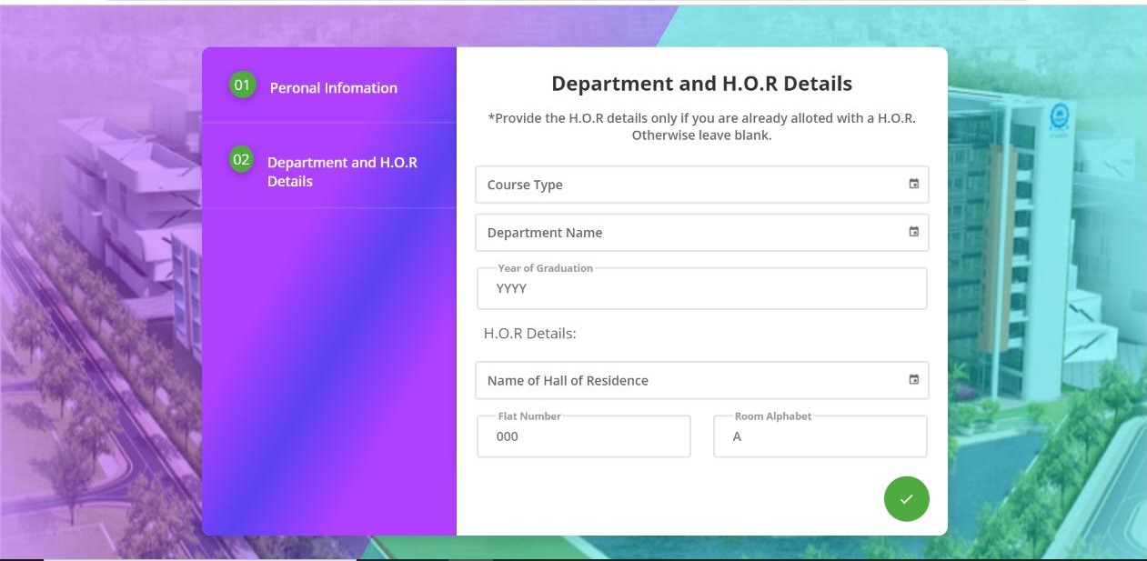
Update Admin Profile/change password

Slide 10
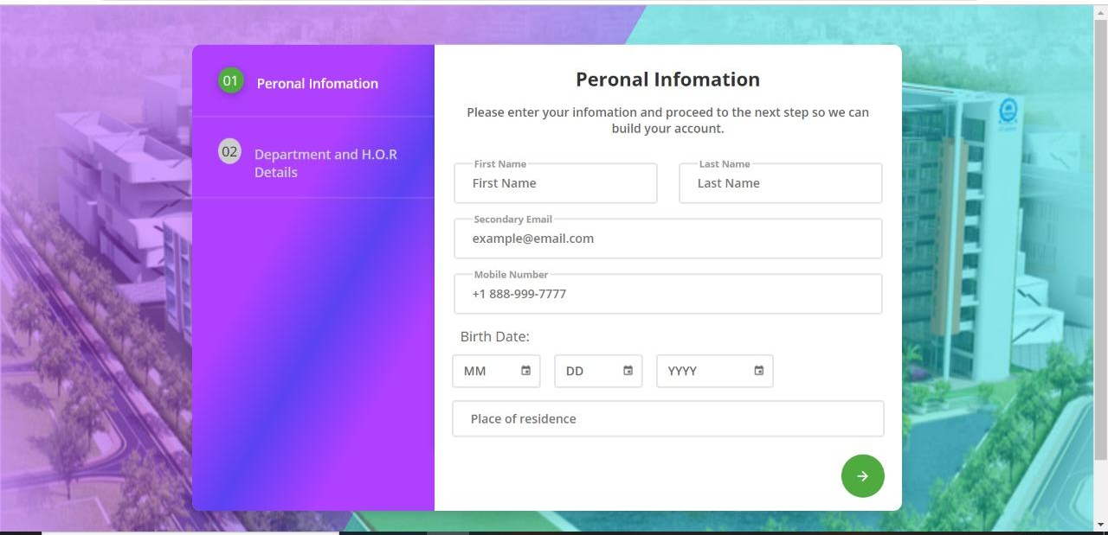
View/Add Admin

Slide 11
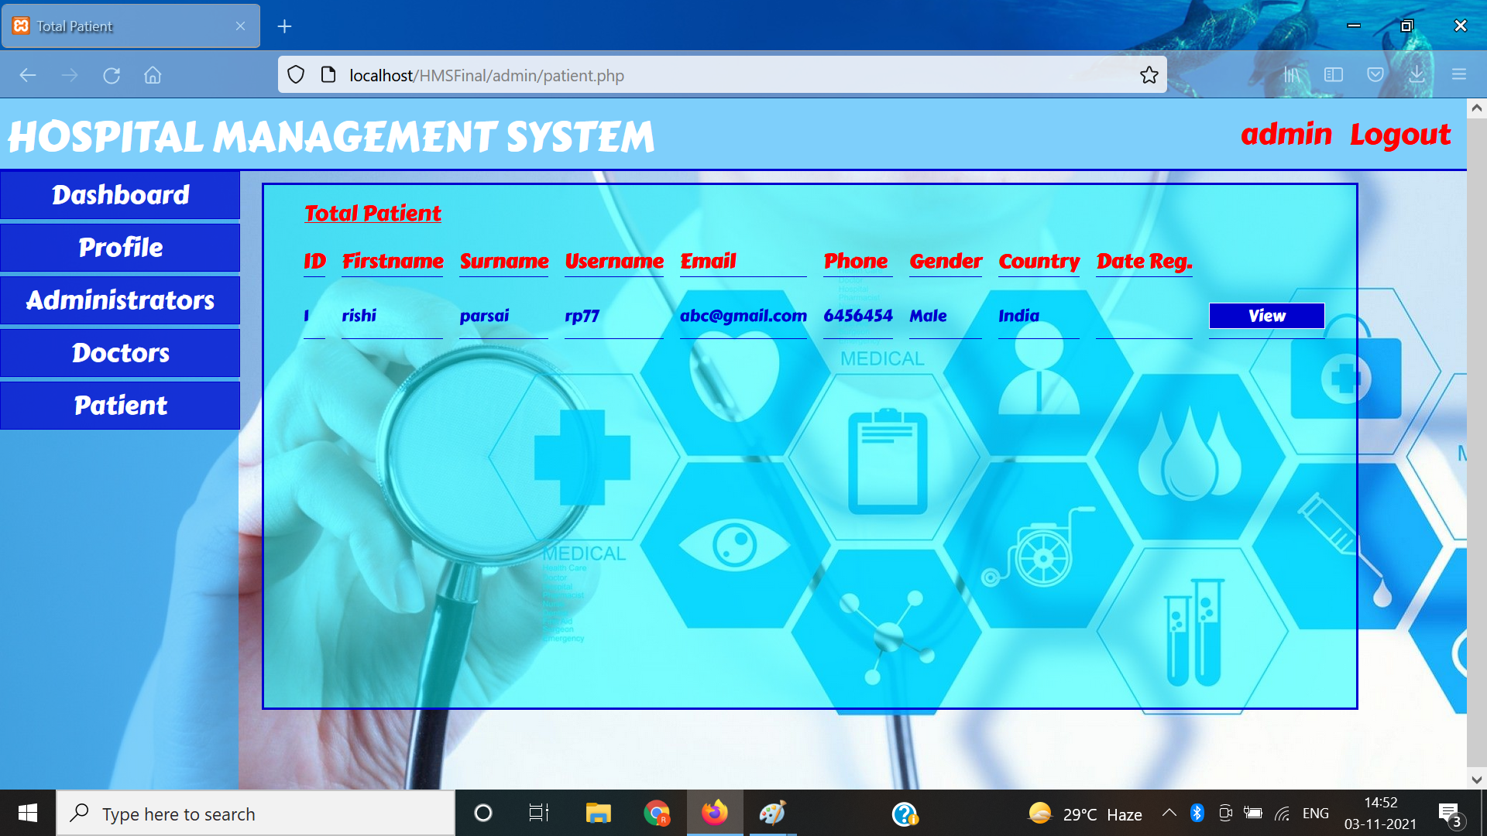
View/Manage Patients

Slide 12
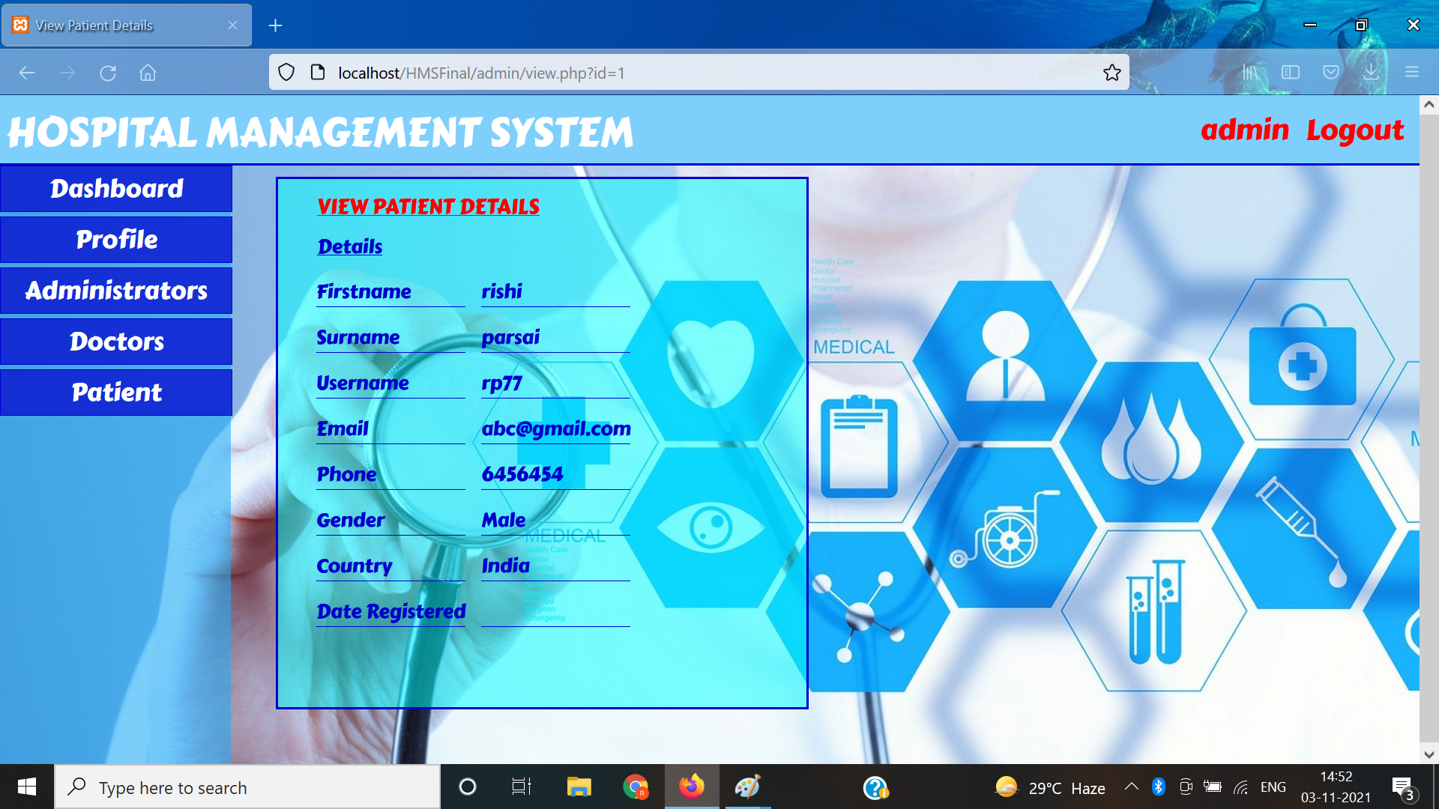
Patient Detail View

Slide 13
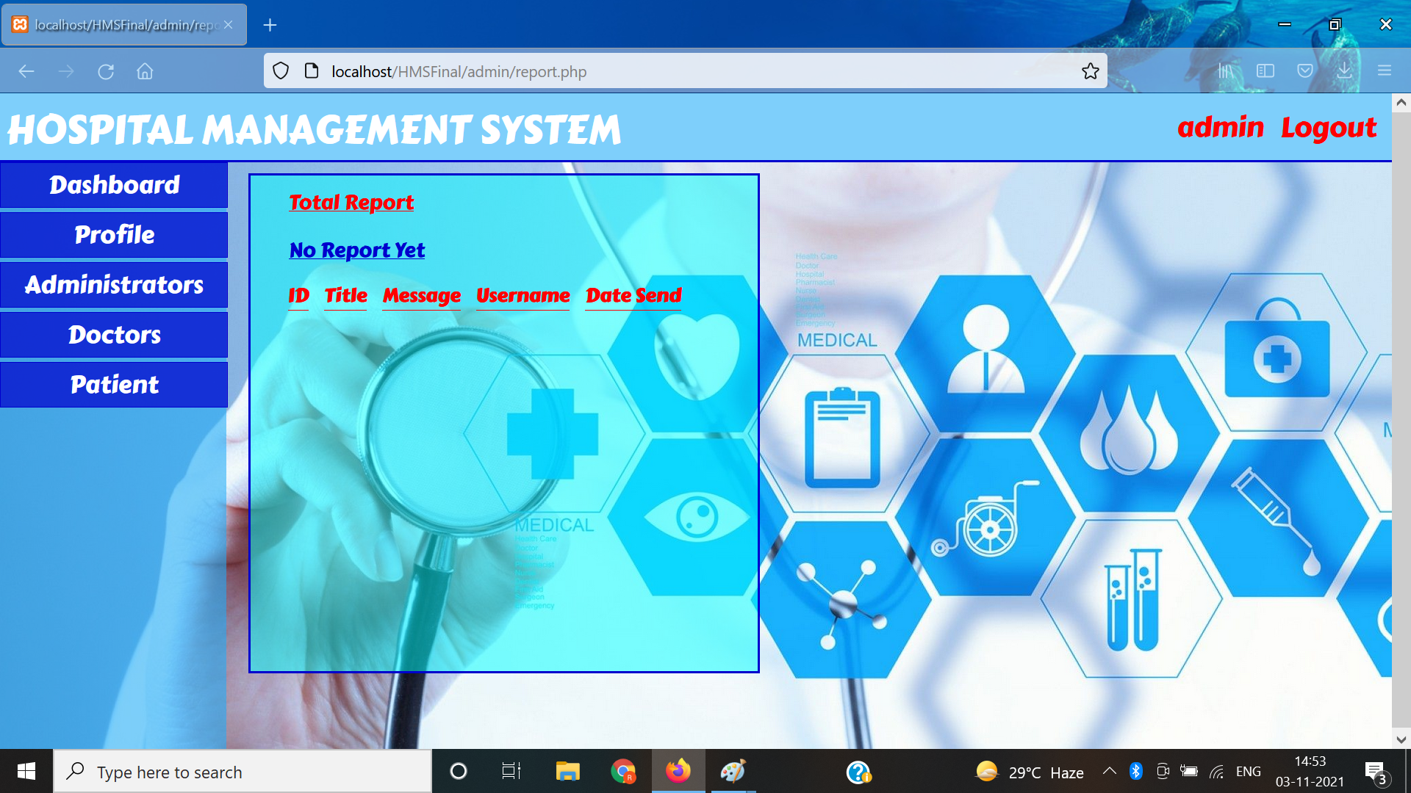
Report View/Manage Page

Slide 14
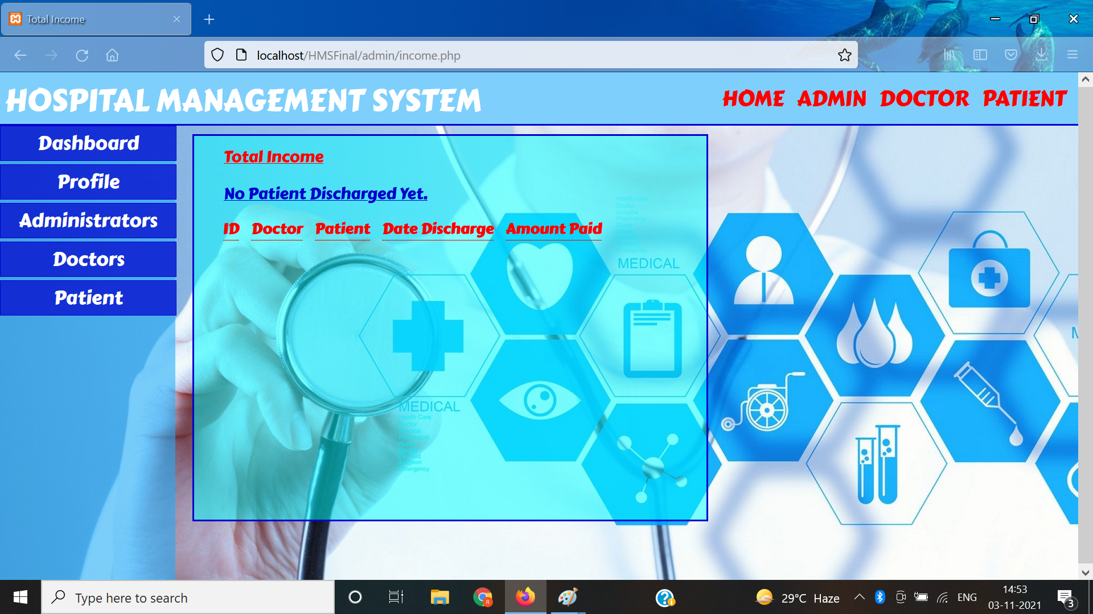
Hospital Finance Management

Slide 15
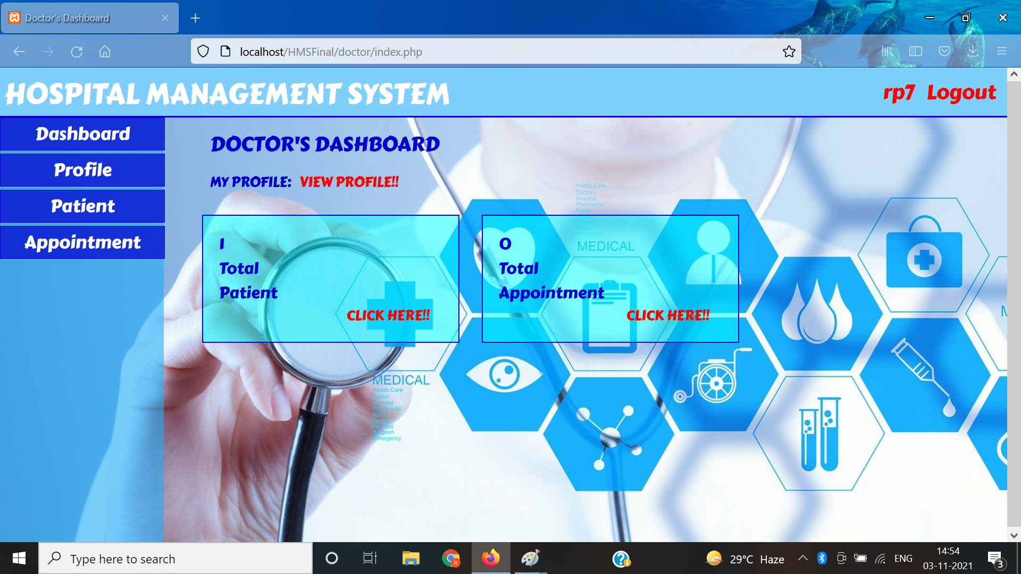
Doctor’s Dashboard

Slide 16
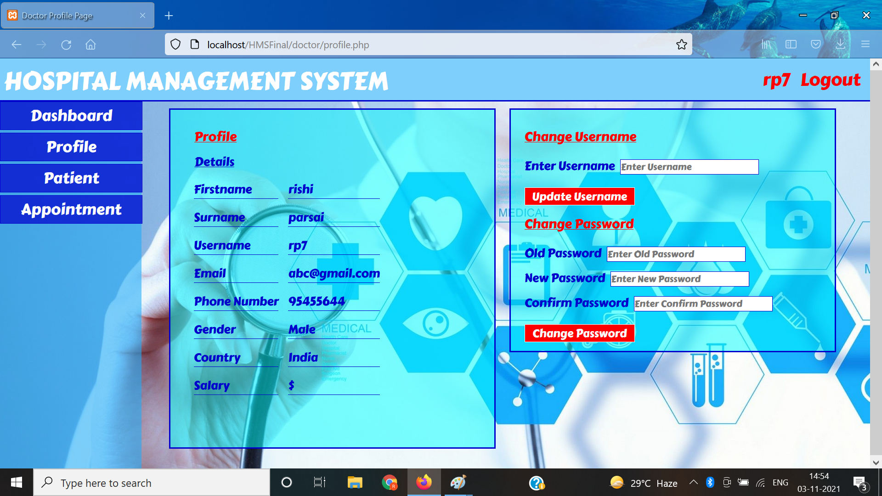
Doctor Profile View/Manage

Slide 17
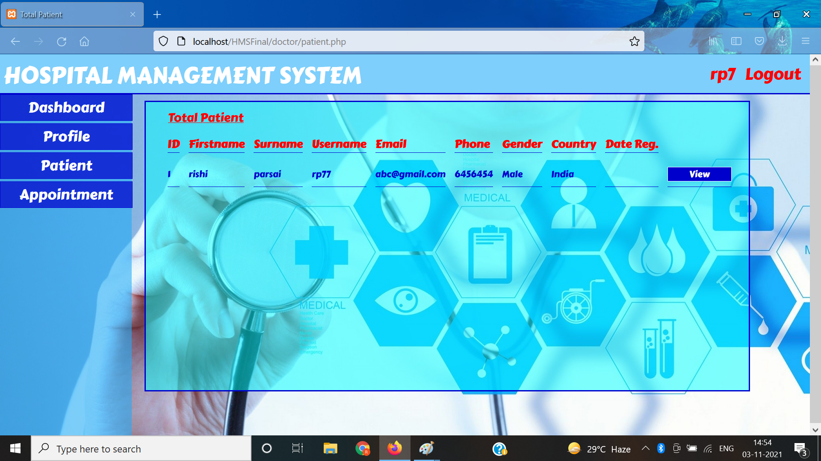
Patient View/Manage

Slide 18
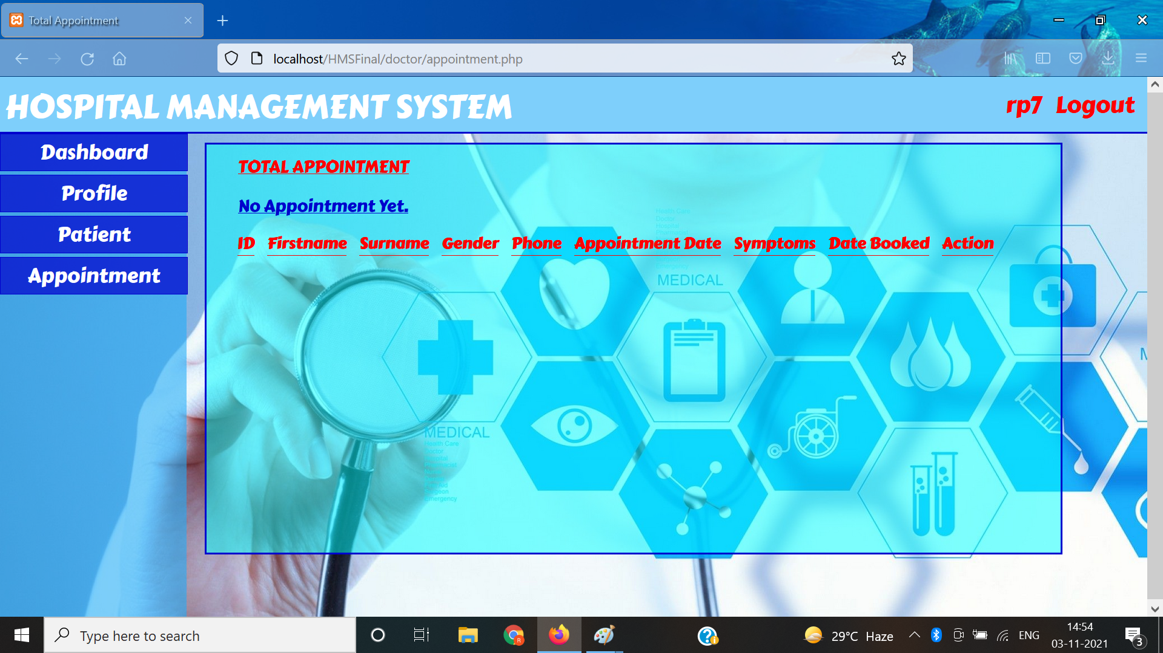
Appointment View/Manage

Slide 19
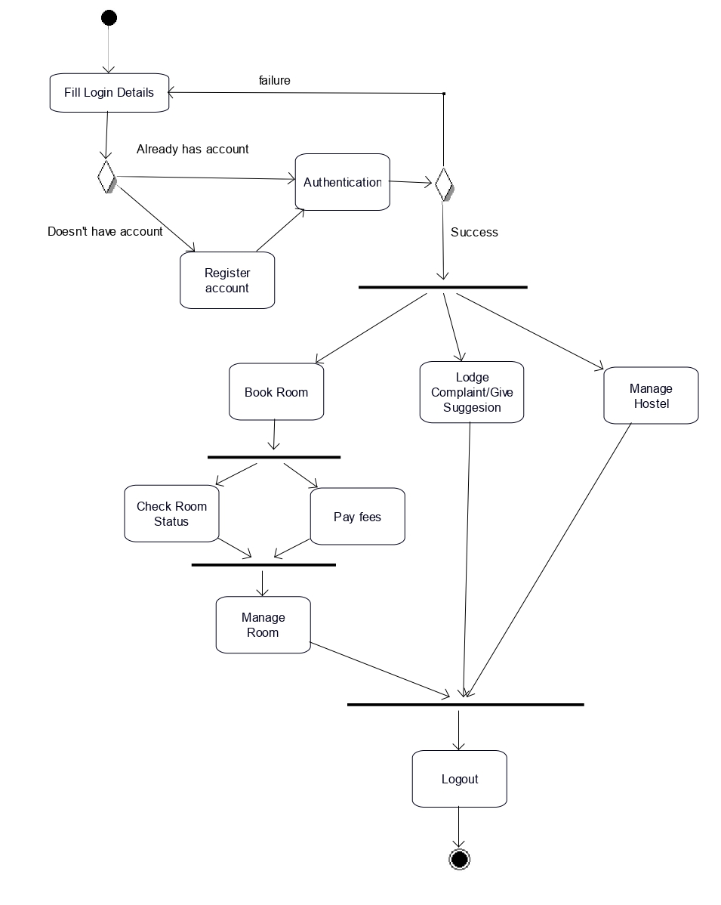
Activity Diagram

Slide 20
Project timeline
1
2
3
4
5
6
Planning
Interface
Creating Database
Application development
Adding Extra Features
Making everything run together
Planning out things and skills needed and the Activity Diagram
Creating Webpage use HTML and CSS
Creating a Database with its tables and attributes
Coding out the app which runs to add entries and commit all the other needed commands
Adding Inventory Management and Automatic Patient ADD/Update
Connecting and pre populating the database and making sure that everything runs properly without error

Slide 21
Points to Discuss
What have you learnt and implemented till now?
Learnt :- we had to learn Node Javascript and hosting a Heroku server.
Implemented :- As mentioned in the Software Requirements Specification (SRS) we made navigation panel, dashboard and feature to add and remove entities. Alongside hosting the pages which use Node and EJS and connect it to a database.
What is your Roadmap
Even if our project is complete and functional we think of continuing adding more features and testing them to gain more skill and experience.
Tools/Languages we used :- HTML, CSS, Node.js, EJS, MongoDB.
Outline :- Hostel Management System
Usability of project/examples
Hostels
Can be changed a bit to implement in other residential and hospitability systems
Some features like gallery, complaint and suggestion management system can be used any other platforms

Slide 22
5. Contribution of Members
200001053 Nilay Ganvit
Documentation of the project
Designing the Structure and coding extra features of the project and making UML Diagrams
Planning the Timeline and Roadmap along with creation of slides and presentation
200001068 Rishi Parsai
HTML, CSS and all the Designing the Frontend and UI of the webpage
Making the Structure more easily usable and customer friendly
Ensuring that functionality is compatible with Design
200001069 Sanskar Verma
Combining, Downloading and Uploading parts of everyone else
Managing Resources and maintenance of versions of the project
Finding proper resources and materials
200001071 Saurabh Kumar Singh
Debugging and Removing Errors from the code
Maintaining Integrity of the Database and making the structure of the whole project
Hosting and Running the project while ensuring that all works together
200001080 Vipul Mahajan
Login, Logout mechanisms including storing and management of database.
Profile information storage and Editing
Setting up the Backend and Database ready for use

Slide 23

Thank you!
200001053 Nilay Jayantibhai Ganvit
200001068 Rishi Parsai
200001069 Sanskar Verma
200001071 Saurabh Kumar Singh
200001080 Vipul Mahajan

